Slide 1
Welcome to the Presentation
Presented By –
Prof. Dr. M Sayadur Rahman
CAS, IUBAT

Slide 2
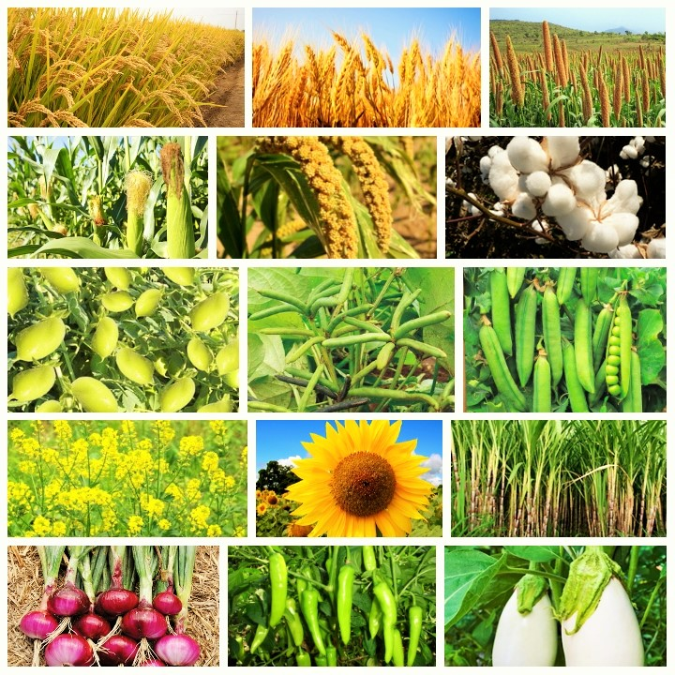
Presentation on: Classification of Crop

Slide 3
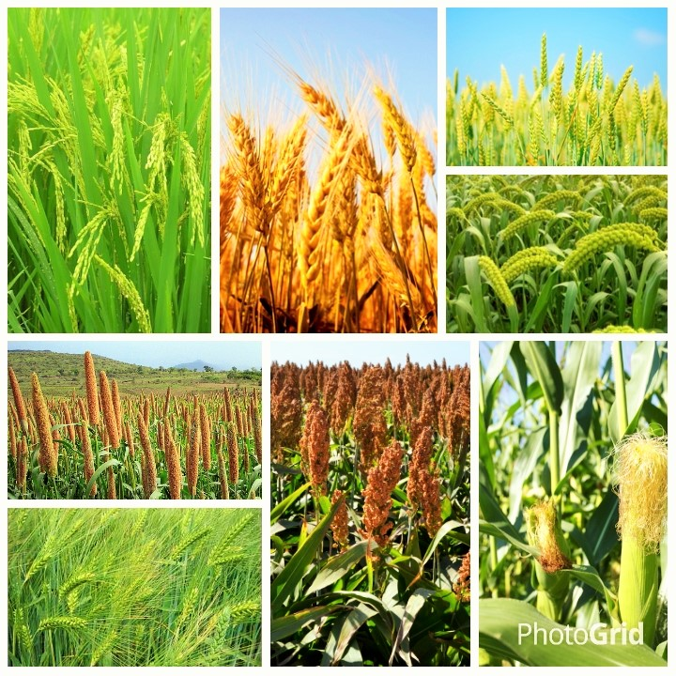
Cereal Crop

Slide 4
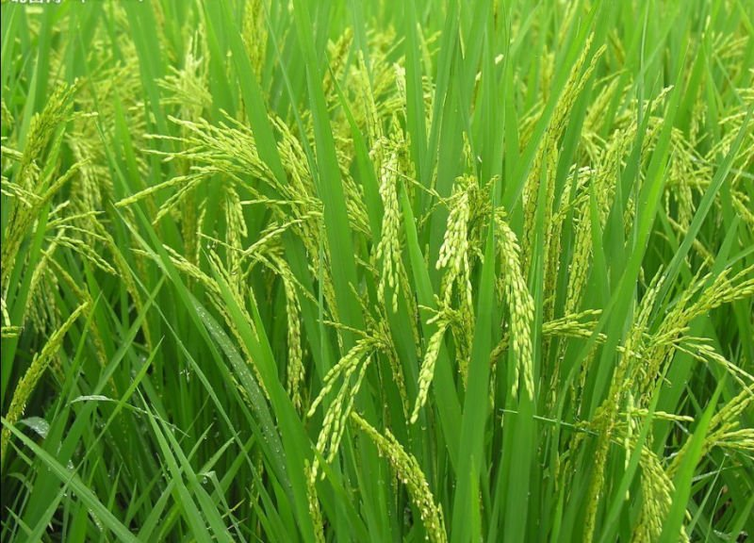
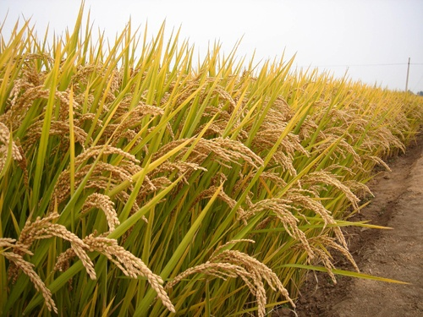
RICE
Common Name: Dhan
Scientific Name: Oryza sativa
Family: Gramineae

Slide 5
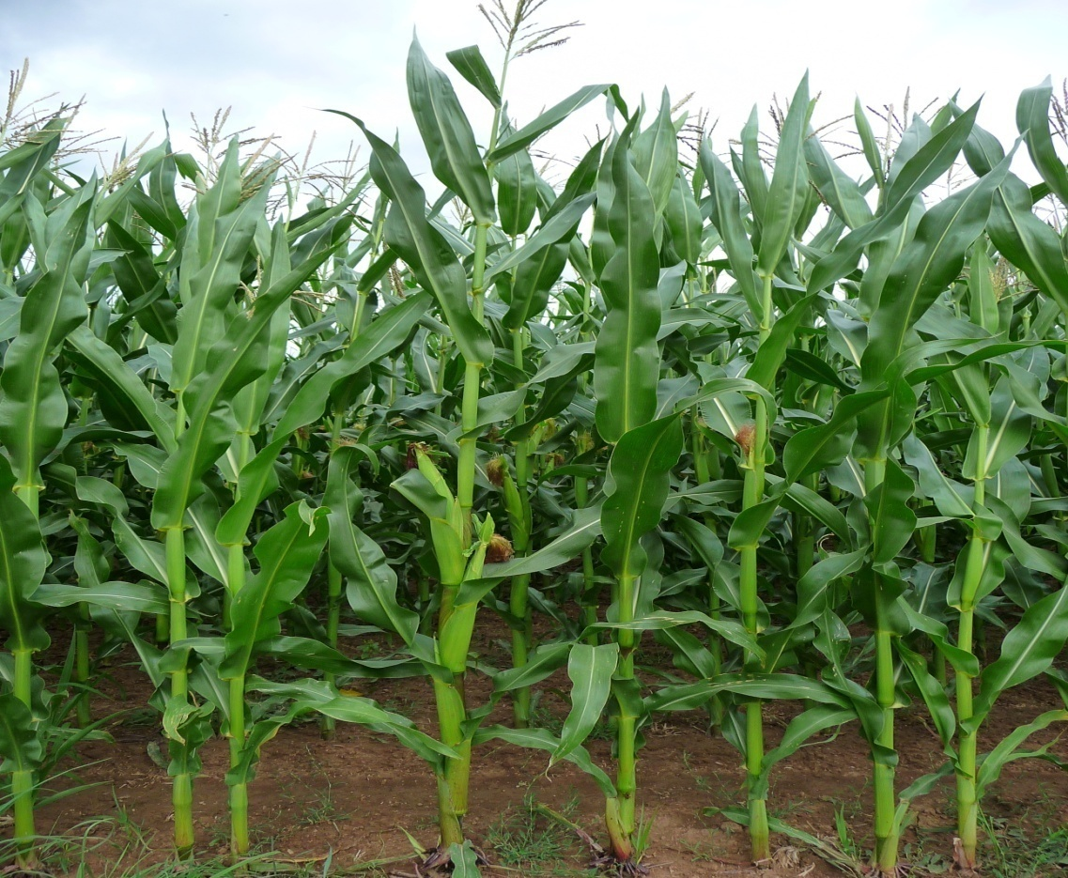
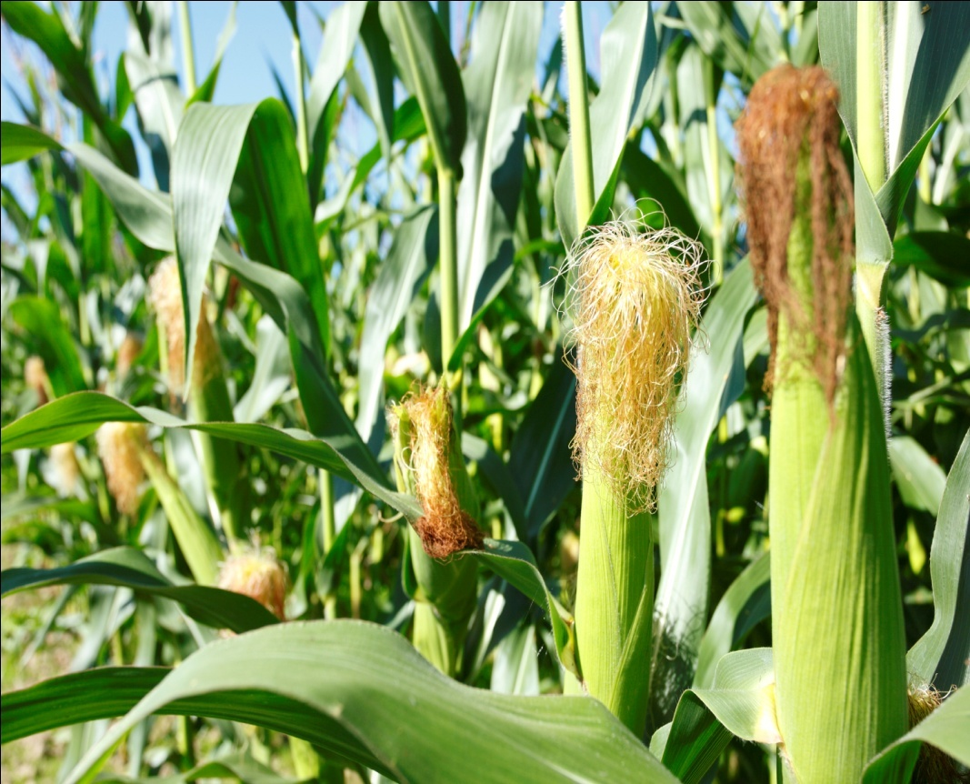
Maize
Common Name: Bhutta
Scientific name: Zea mays
Family: Gramineae

Slide 6
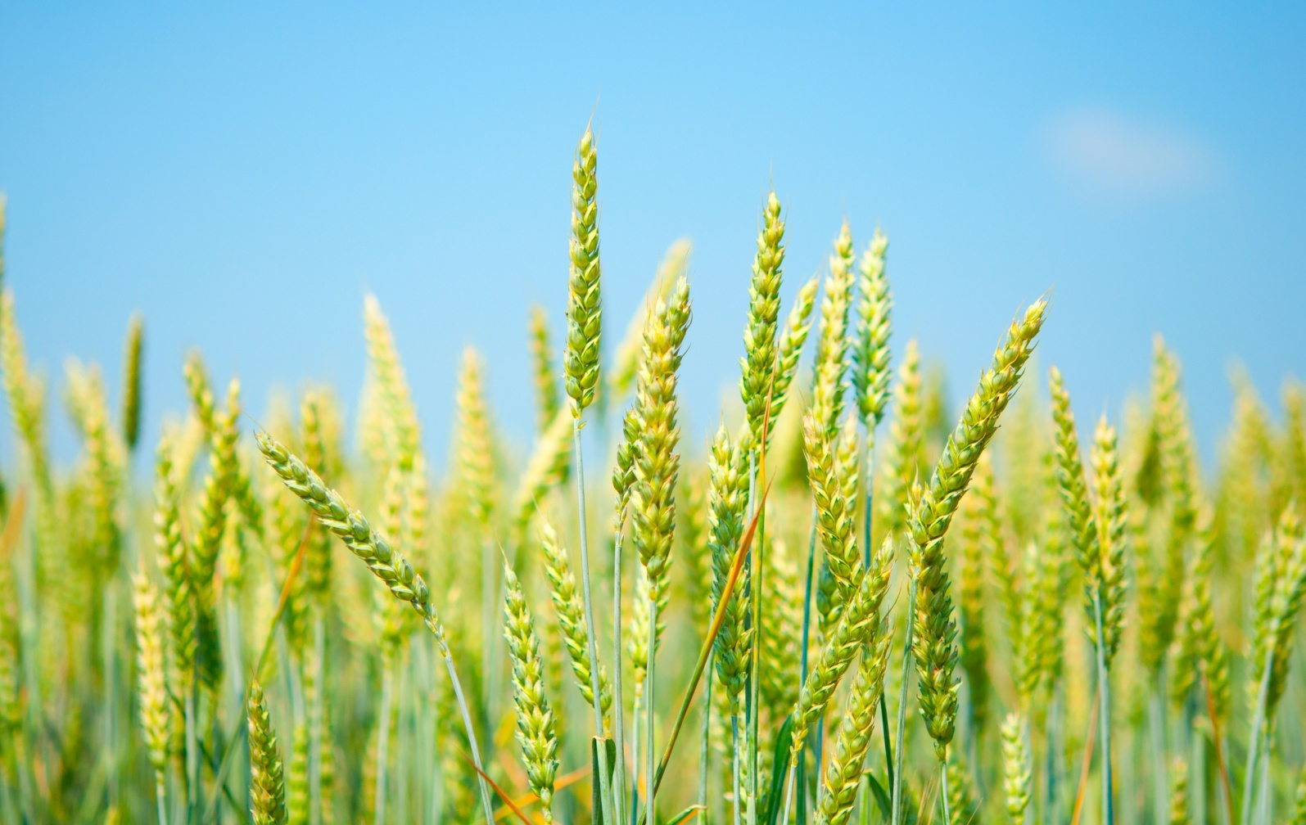
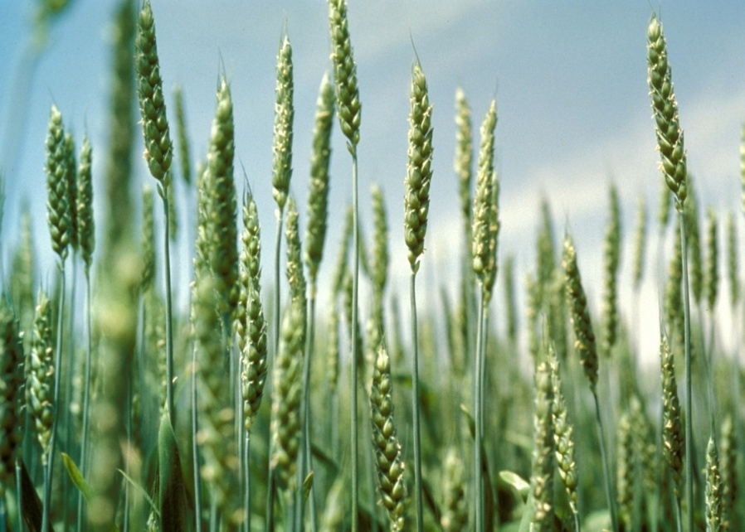
Wheat
Common Name: Ghom
Scientific Name: Triticum aestivum
Family: Gramineae

Slide 7
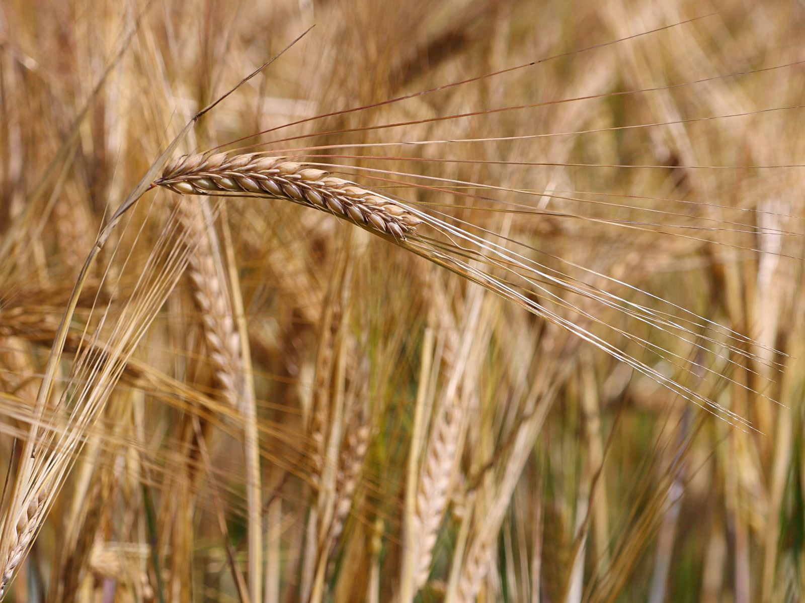
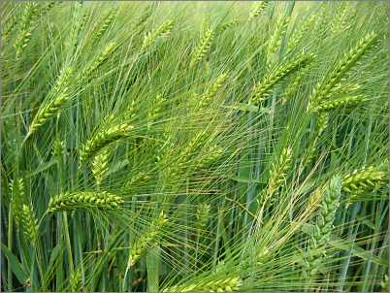
Barley
Common name: Job
Scientific Name: Hordeum vulgare
Family: Gramineae

Slide 8
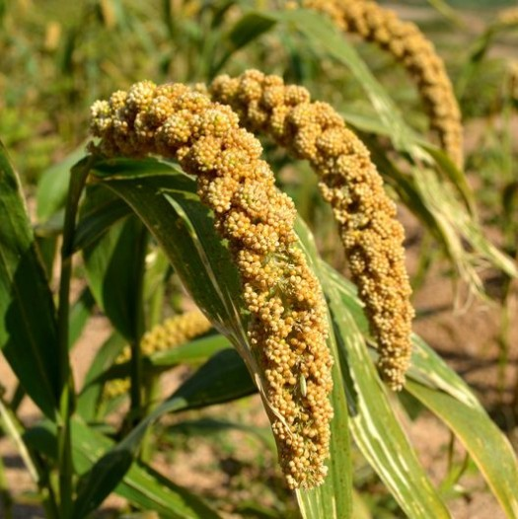
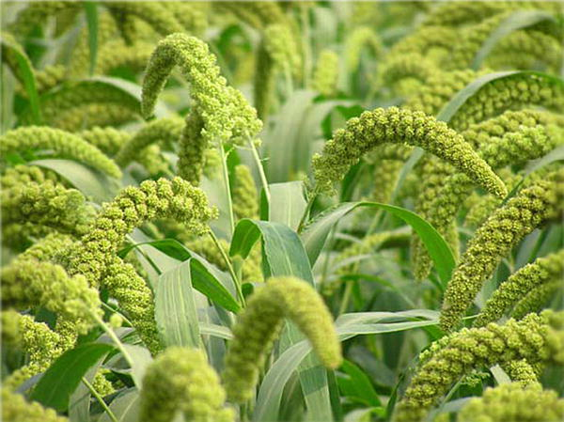
Foxtail Millet
Common Name: Kaon
Scientific Name: Panicum miliaceum
Family: Gramineae

Slide 9
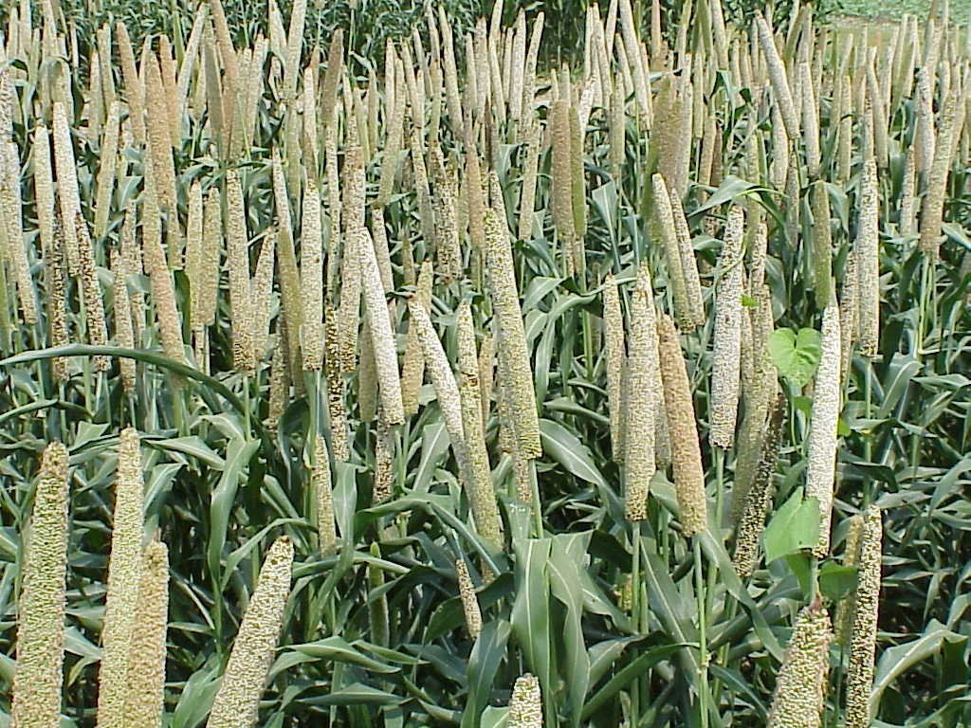
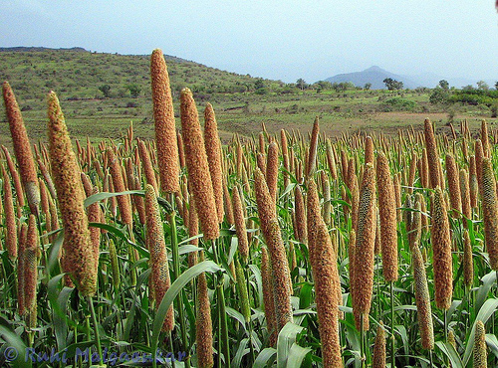
Russian Millet
Common name: Cheena
Scientific Name: Panicum miliacium
Family: Gramineae

Slide 10
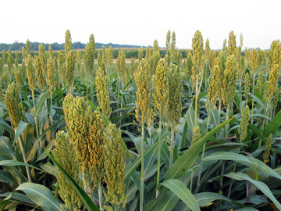
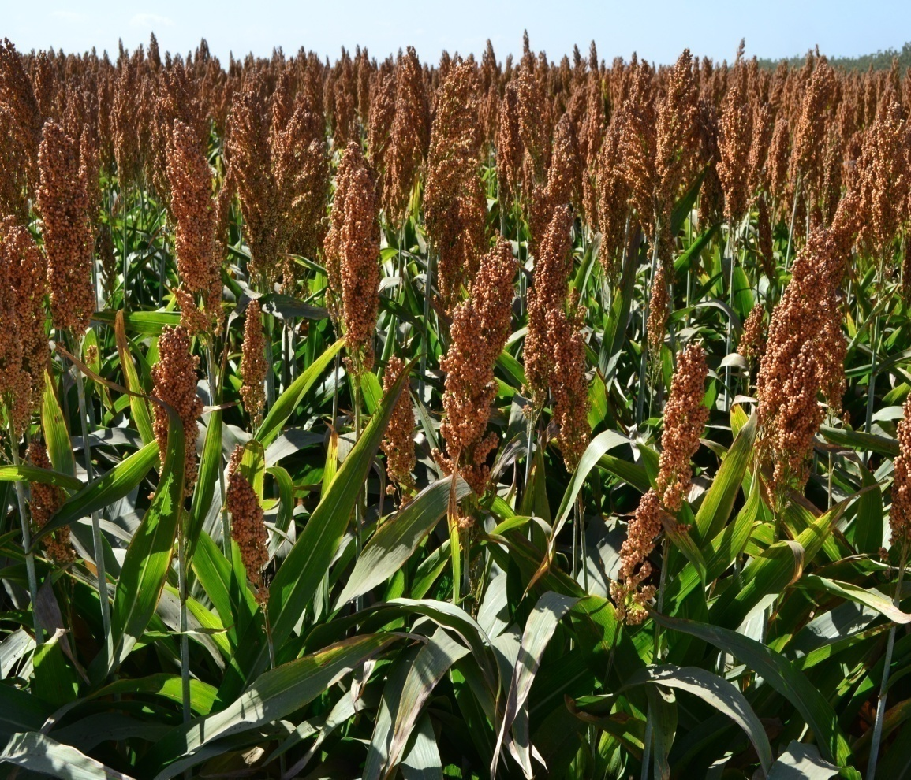
Sorghum
Common Name: Jowar
Scientific Name: Sorghum bicolor
Family: Gramineae

Slide 11
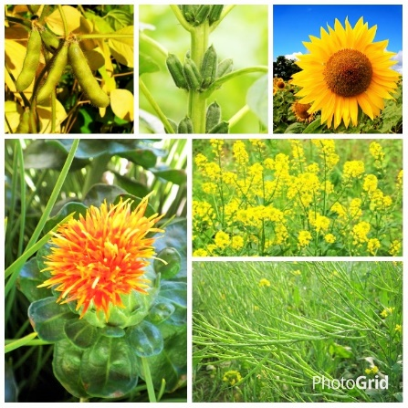
Oilseeds

Slide 12
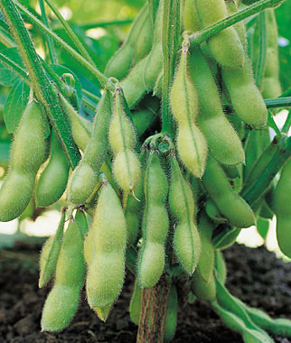
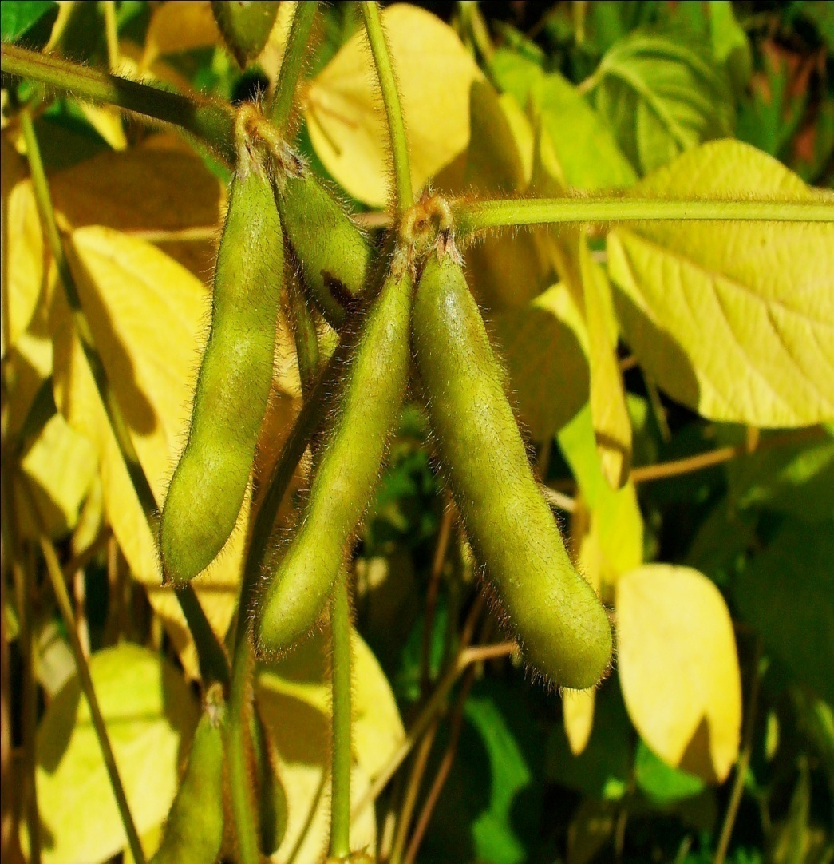
Soybean
Common Name: Soybean
Scientific Name: Glycine max
Family: Leguminosae

Slide 13
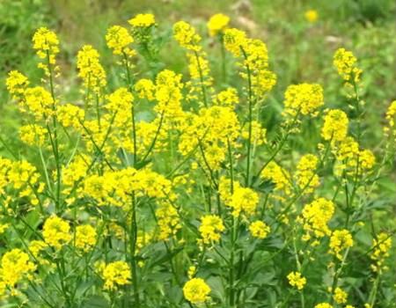
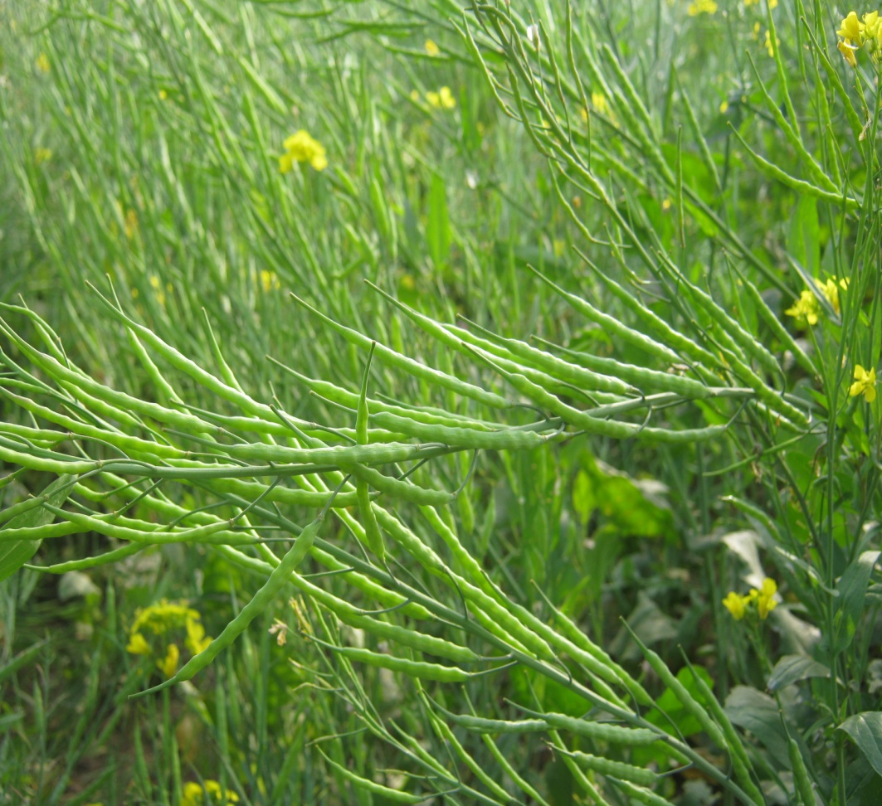
Mustard
Common Name: Sorisha
Scientific name: Brassica spp
Family: Cruciferae

Slide 14
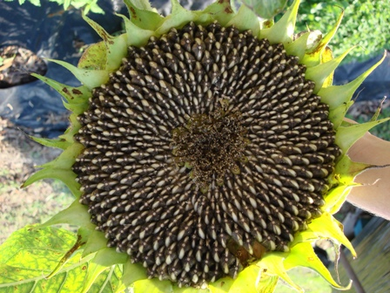
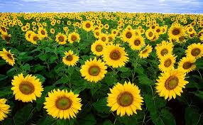
Sunflower
Common Name: Surjomukhi
Scientific Name: Helianthus annuus
Family: Asteraceae

Slide 15
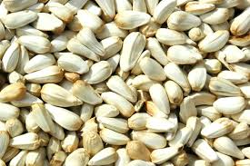
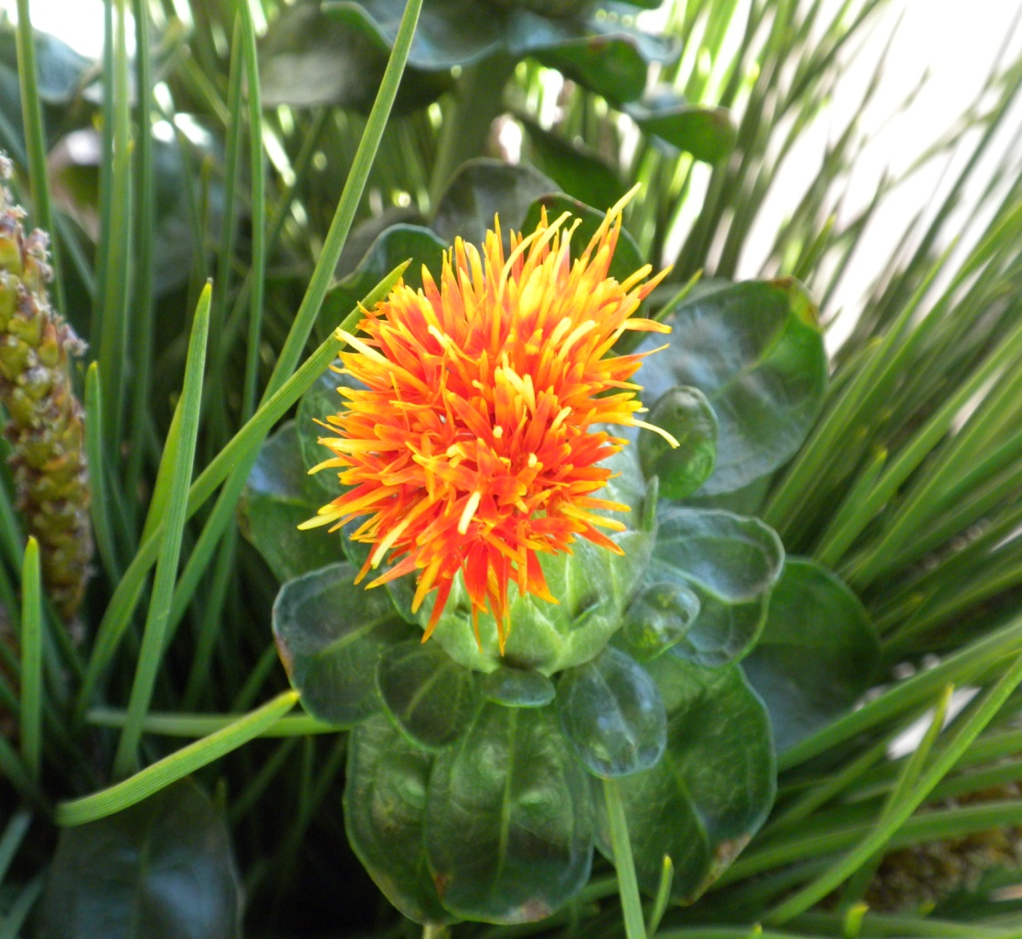
Safflower
Common Name: Kushumful
Scientific Name: Carthamus spp
Family: Compositae

Slide 16
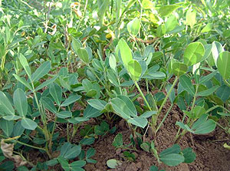
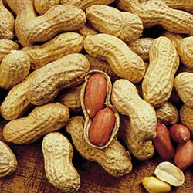
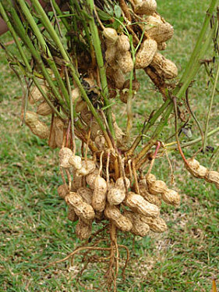
Groundnut
Common Name: Cheena Badam
Scientific Name: Arachis hypogaea
Family: Leguminosae

Slide 17
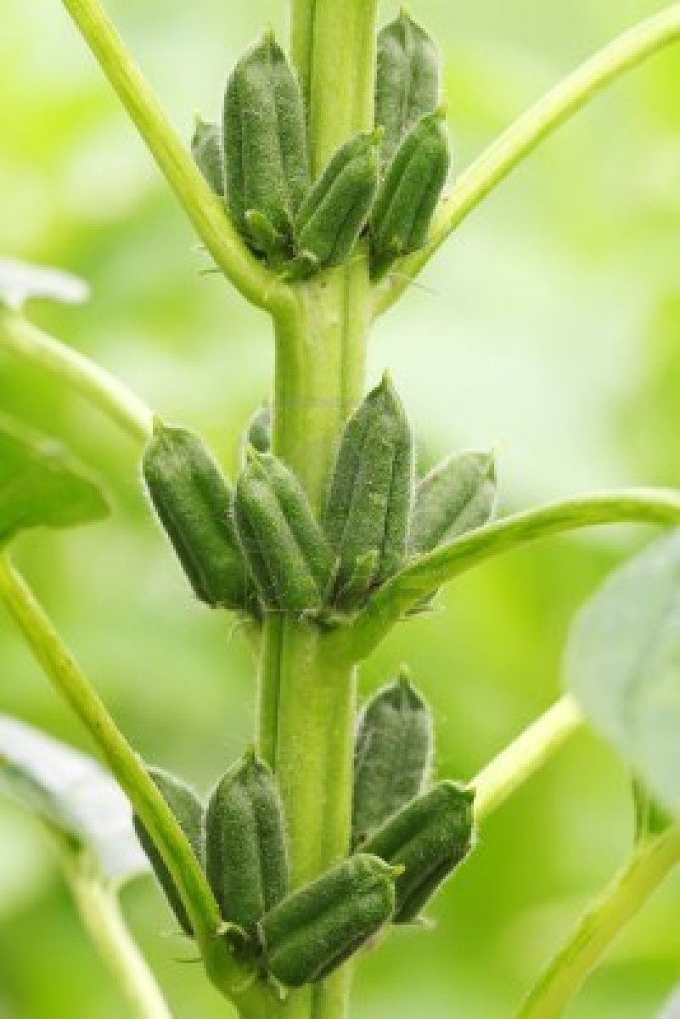
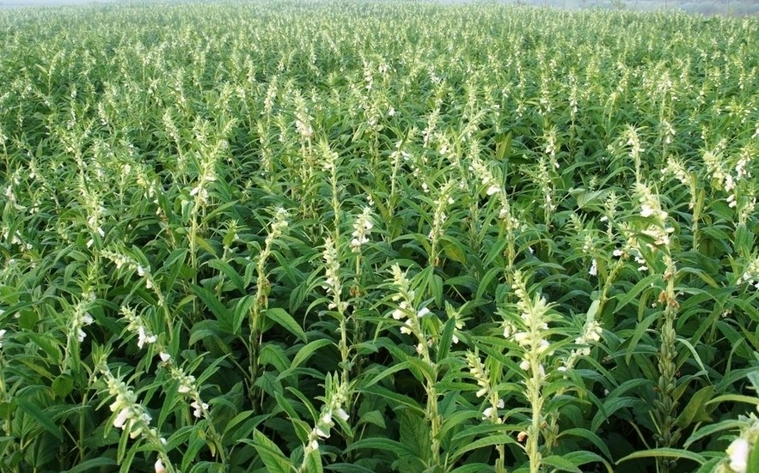
Sesame
Common Name: Til
Scientific Name: Sesamum indicum
Family: Pedaliaceae

Slide 18
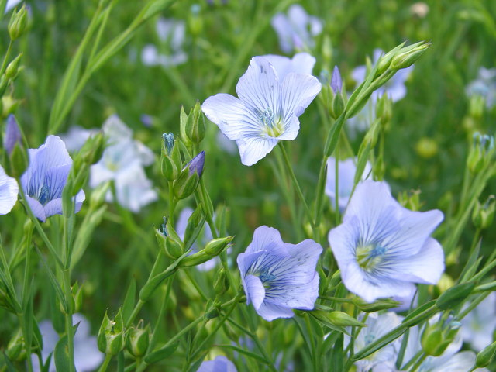
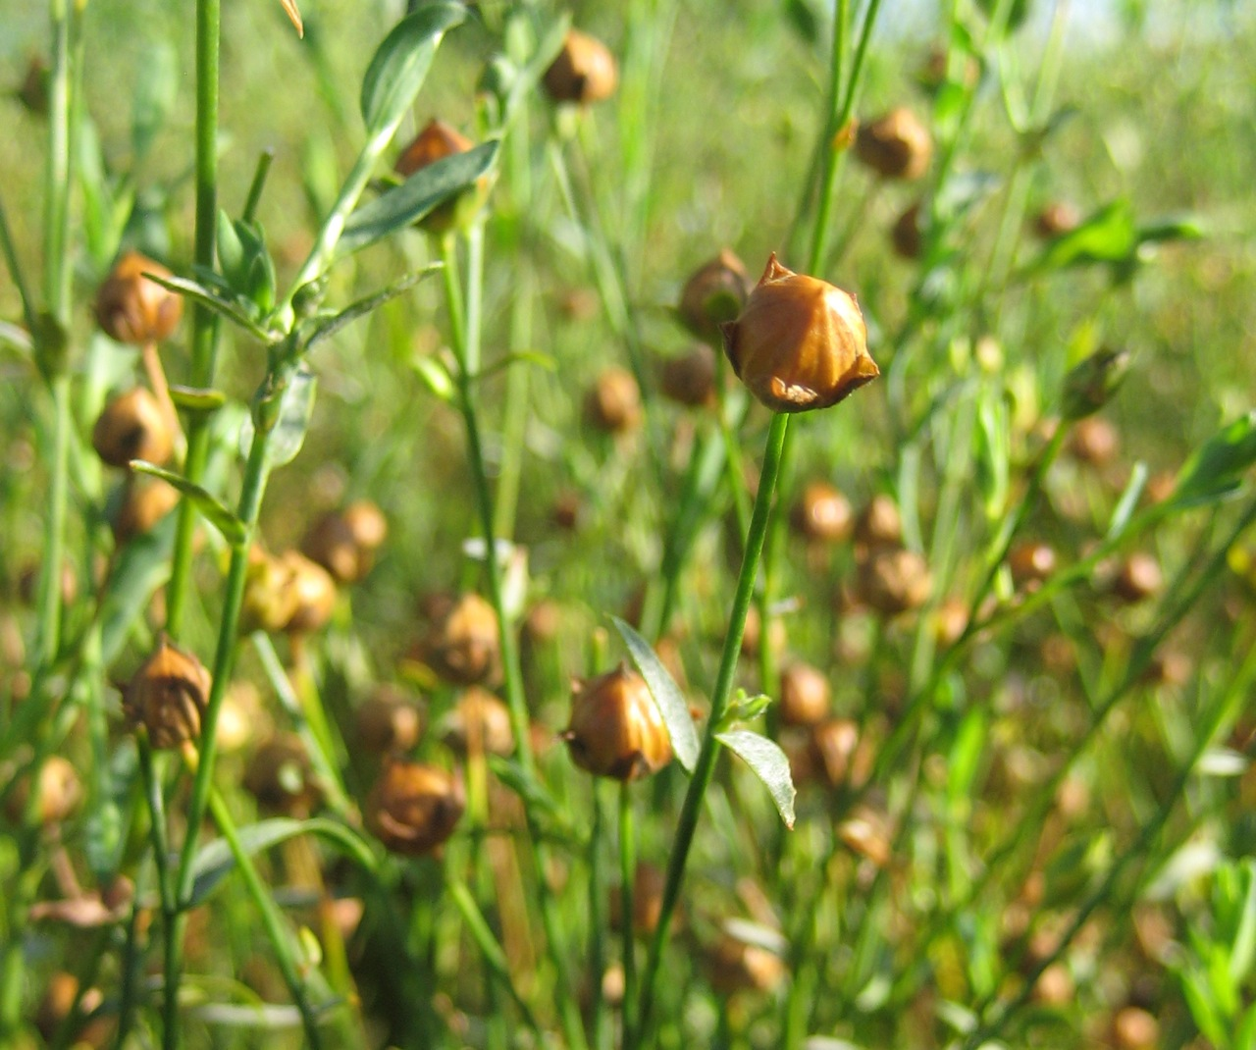
Linseed
Common Name: Tishi
Scientific Name: Linum usitatissimum
Family: Linaceae

Slide 19
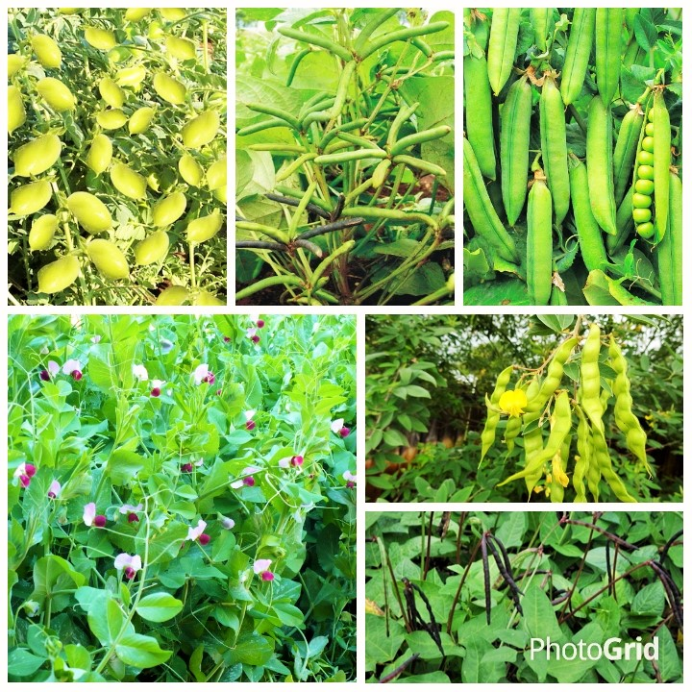
Pulse Crop

Slide 20
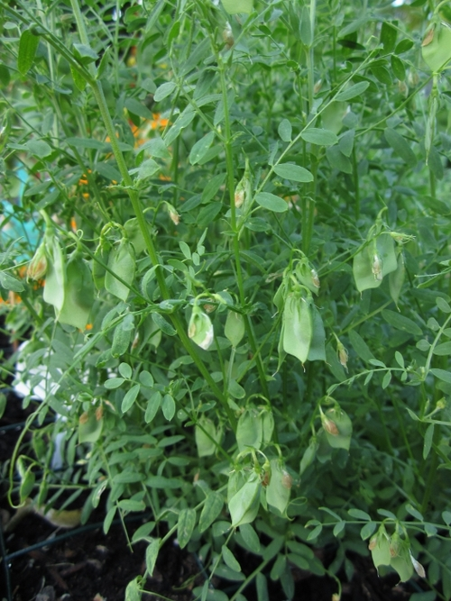
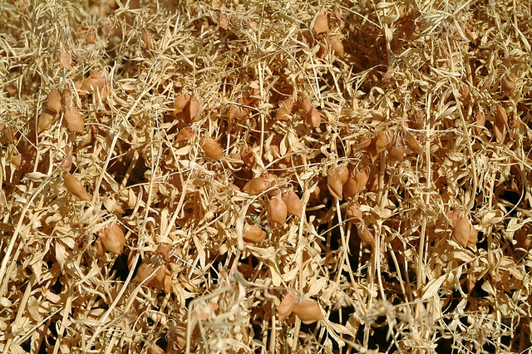
Lentil
Common Name: Mushur
Scientific Name: Lens culinaris
Family: Leguminosae

Slide 21
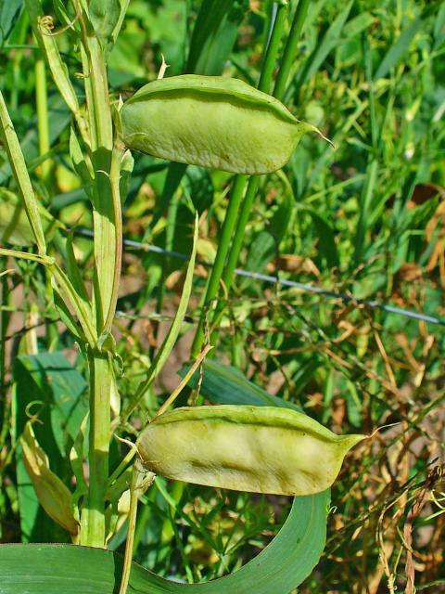
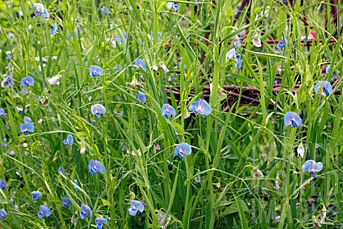
Grass Pea
Common Name:
Scientific Name: Lathyrus sativus
Family: Leguminosae

Slide 22
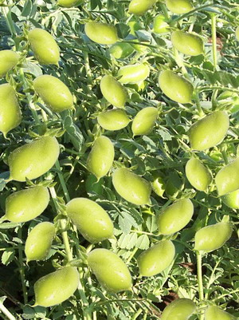
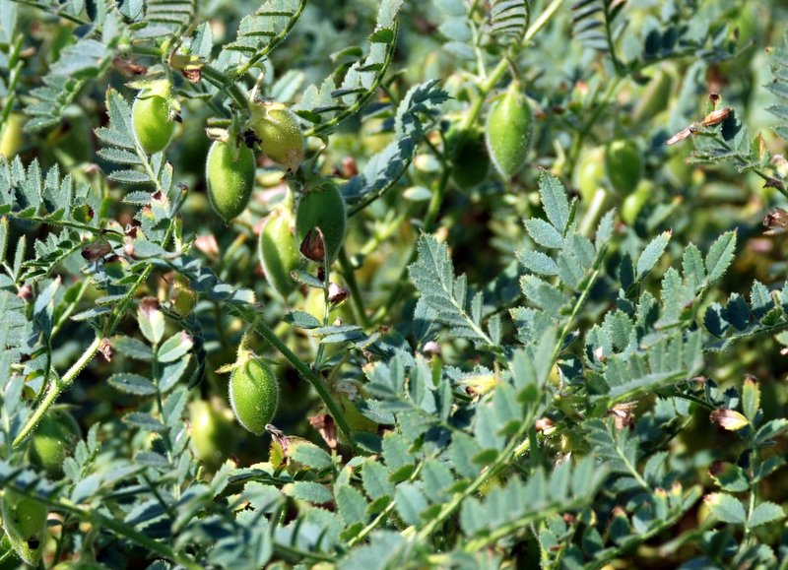
Chickpea
Common Name: Chola
Scientific Name: Cicer arietinum
Family: Leguminosae

Slide 23
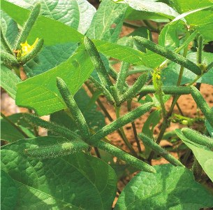
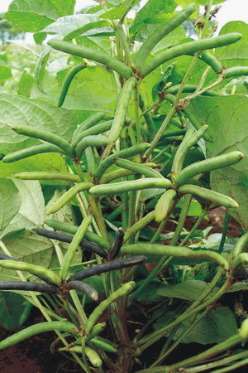
black Gram
Common Name: Mash Kalai
Scientific Name: Phaseolus vulgaris
Family: Leguminosae

Slide 24
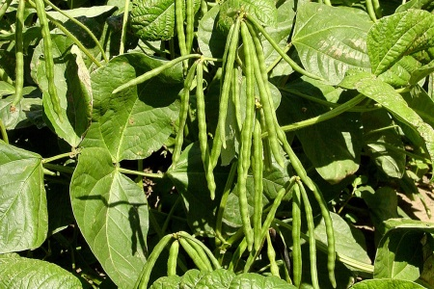
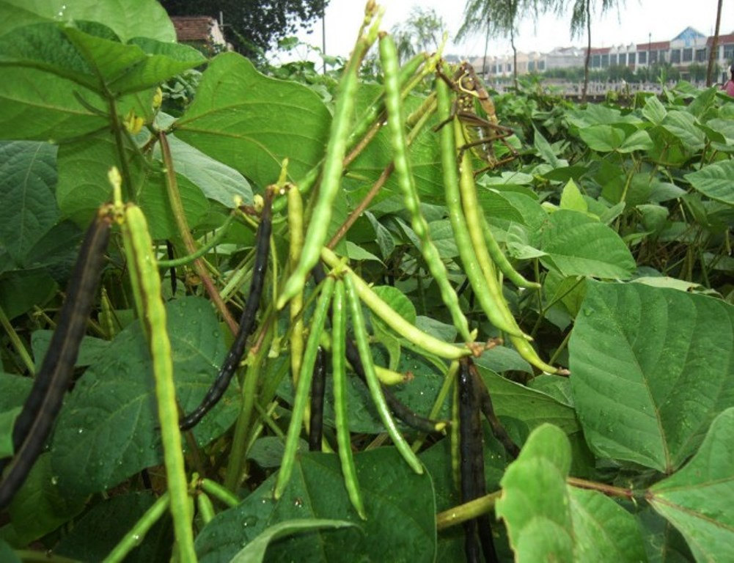
Mung Bean
Common Name: Mug kalai
Scientific name: Vigna radiata
Family: Leguminosae

Slide 25
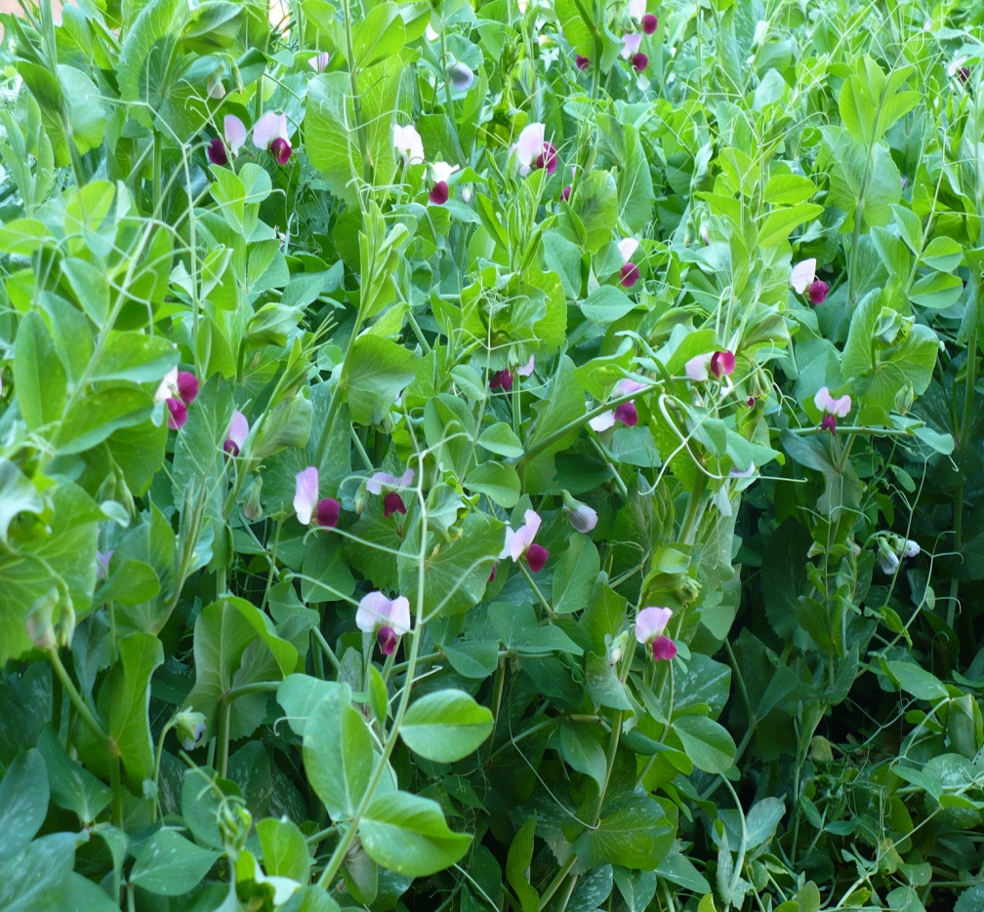
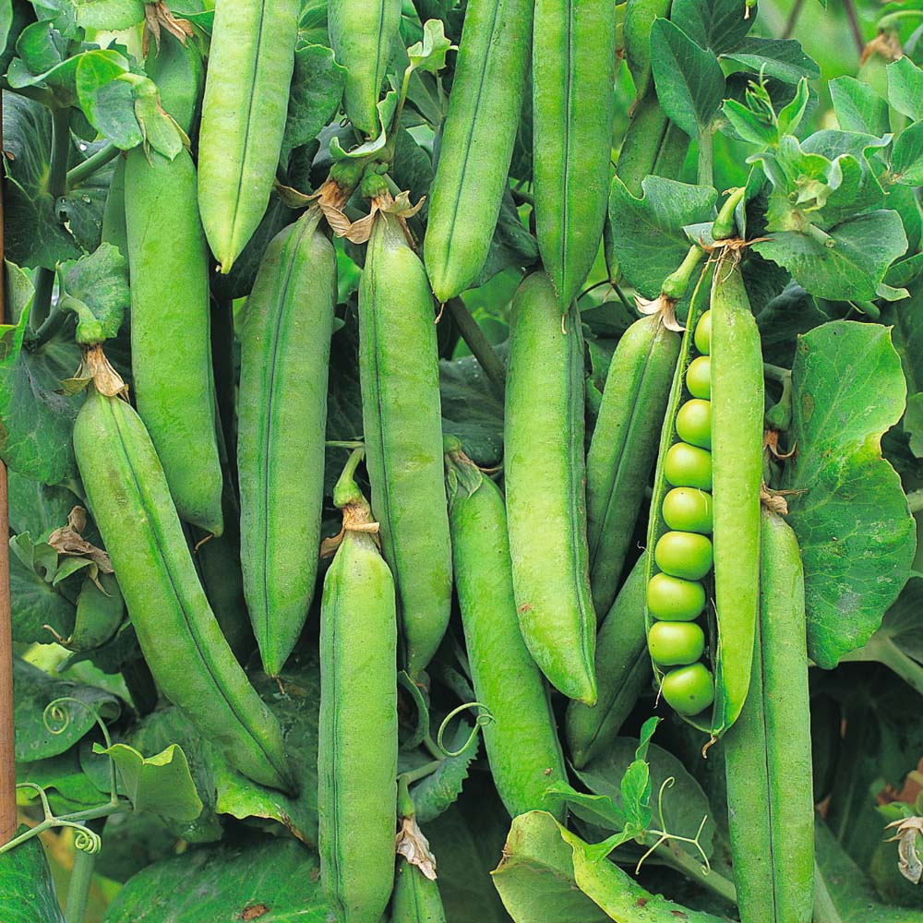
Garden pea
Common name: Motor
Scientific Name: Pisum sativum
Family: Leguminosae

Slide 26
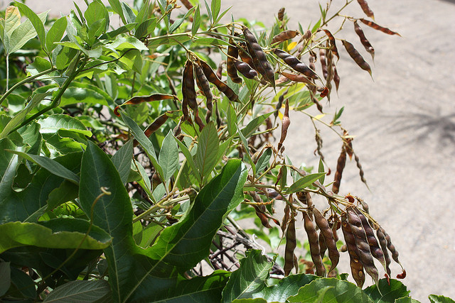
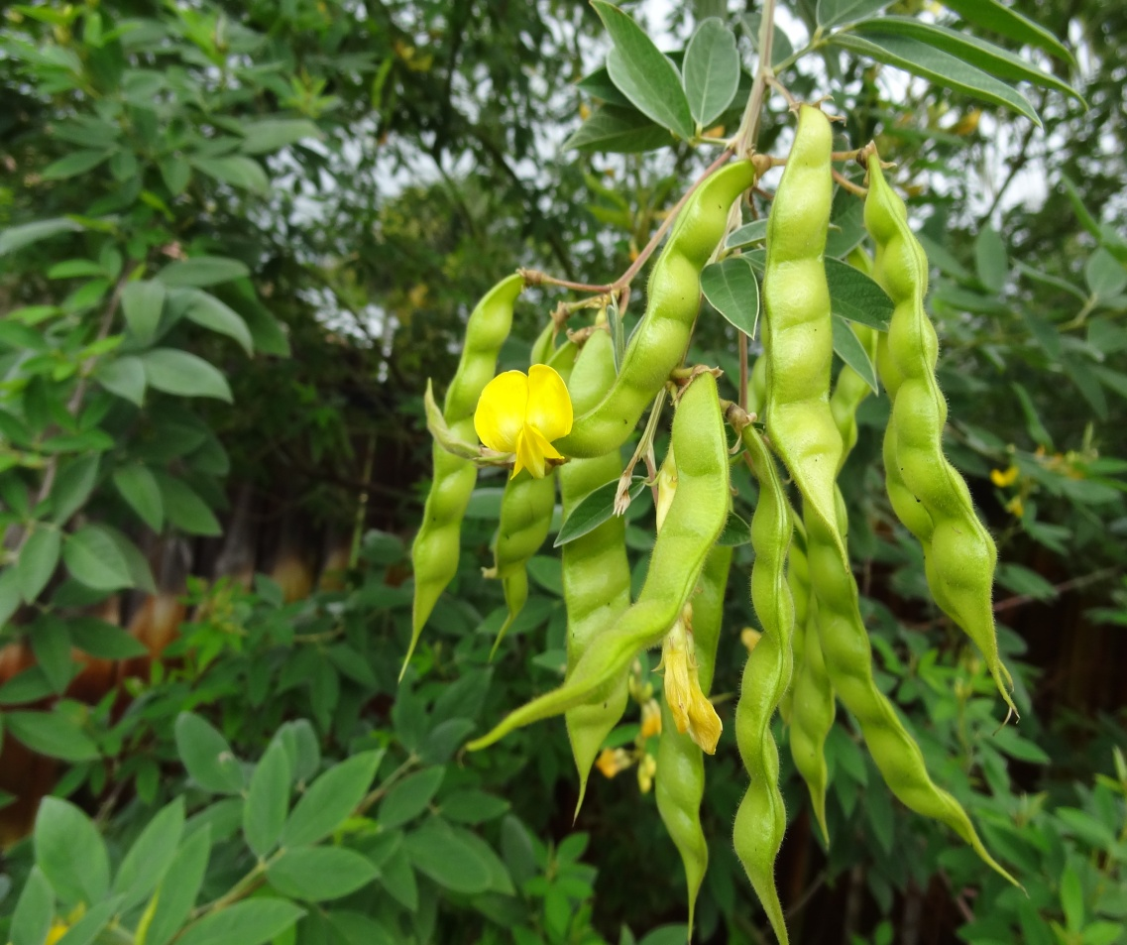
Pigeon pea
Common Name: Arhar
Scientific Name: Cajanus cajan
Family: Leguminosae

Slide 27
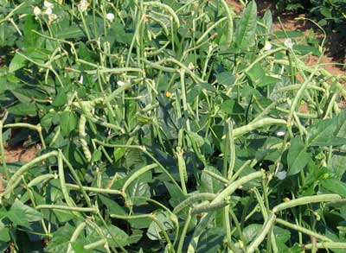
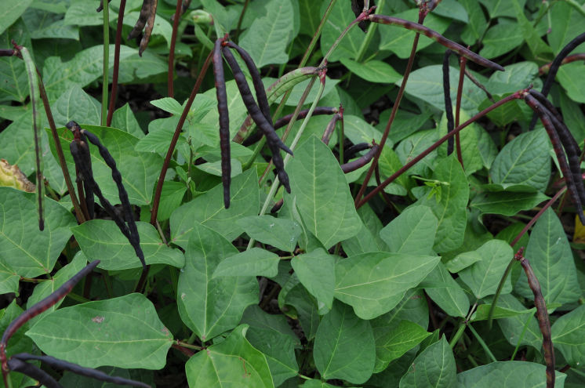
Cow pea
Common Name: Gomotor
Scientific Name: Vigna unguiculata
Family: Leguminosae

Slide 28
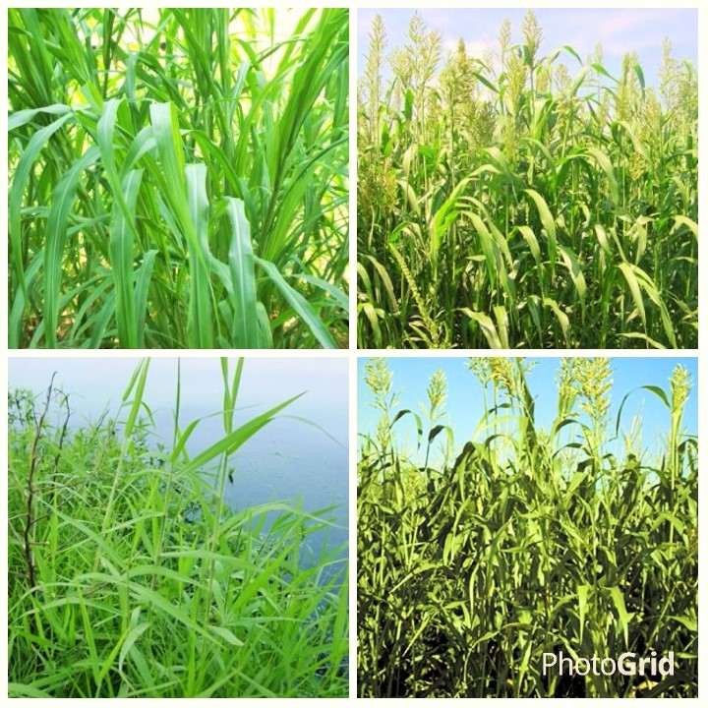
Forage Crop

Slide 29


Para Grass
Common Name: Para
Scientific Name: Brachiaria mutica
Family: Poaceae

Slide 30


Napier grass
Common Name: Napier grass
Scientific Name: Pennisetum purpureum
Family: Poaceae

Slide 31


Sudan grass
Common Name: Sudan Grass
Scientific Name: Pennisetum purpureum
Family: Poaceae

Slide 32

Fiber Crop

Slide 33


Jute
Common Name: Pat
Scientific Name: Corchorus capsularis
Family: Poaceae

Slide 34


Kenaf
Common Name: Mesta
Scientific Name: Hibiscus cannabinus
Family: Malvaceae

Slide 35


Cotton
Common Name: Tula
Scientific Name: Gossypium
Family:

Slide 36


hemp plant
Common Name: Hemp
Scientific Name: Cannabis indica
Family: Cannabaceae

Slide 37

Sugar Crop

Slide 38


SugarcanE
Common Name: Aakh
Scientific Name: Saccharum officinarum
Family: Poaceae

Slide 39


Sugar beet
Common Name: Suger beet
Scientific Name: Beta vulgaris
Family: Amaranthaceae

Slide 40

Spices

Slide 41


Onion
Common Name: Peyaj
Scientific Name: Allium cepa
Family: Amaryllidaceae

Slide 42


Ginger
Common Name: Ada
Scientific Name: Zingiber officinale
Family: Zingiberaceae

Slide 43


Chili
Common Name: Moric
Scientific Name: Capsicum annuum
Family: Solanaceae

Slide 44


CoriANDER
Common Name: Dhonia
Scientific Name: Coriandrum sativum
Family: Apiaceae

Slide 45

Vegetable Crop

Slide 46


Brinjal
Common Name: Begun
Scientific Name: Solanum melongena
Family: Solanaceae

Slide 47


Tomato
Name: Tomato
Scientific Name: Solanum lycopersicum
Family: Solanaceae

Slide 48


Cabbage
Common Name: Badhakopi
Scientific Name: Brassica oleracea
Family: Brassicaceae

Slide 49


Cauliflower
Common Name: Fulkopi
Scientific Name: Brassica oleracea
Family: Cruciferae

Slide 50


Broccoli
Common Name: Brocoli
Scientific Name: Brassica oleracea
Family: Cruciferae

Slide 51


Radish
Common Name: Mula
Scientific Name: Raphanus sativus
Family: Crucidrae

Slide 52


Bottle Gourd
Common Name: Lau
Scientific Name: Lagenaria siceraria
Family: Cucurbitaceae

Slide 53


Ash Gourd
Common Name: Calkumra
Scientific Name: Benincasa hispida
Family: Cucurbitaceae

Slide 54


Sweet Gourd
Common Name: Misti Kumra
Scientific Name: Cucurbita moschata
Family: Cucurbitaceae

Slide 55


Cucumber
Common Name: Shosa
Scientific Name: Cucumis sativus
Family: Cucurbitaceae

Slide 56


Papaya
Common Name: Papaya
Scientific Name: Carica papaya
Family: Caricaceae

Slide 57


Country Bean
Common Name: Shim
Scientific Name: Lablab niger
Family: Fabaceae

Slide 58


Yard Long Bean
Common Name: Borboti
Scientific Name: Vigna unguiculata
Family: Fabaceae

Slide 59


Okra
Common Name: Derosh
Scientific Name: Abelmoschus esculentus
Family: Malvaceae

Slide 60

Root Crop

Slide 61


Potato
Common Name: Alu
Scientific Name: Solanum tuberosum
Family: Solanaceae

Slide 62


Sweet Potato
Common Name: Misti Alu
Scientific Name: Ipomoea batatas
Family: Convolvulaceae

Slide 63

Drug Crop

Slide 64


Tobacco
Common Name: Alu
Scientific Name: Nicotiana tabacum
Family: Solanaceae

Slide 65


Poppy
Common Name: Poppy
Scientific Name: Papaver somniferum
Family: Papaveraceae

Slide 66

Beverage Crop

Slide 67


TEA
Common Name: Cha
Scientific Name: Camellia sinensis
Family: Theaceae

Slide 68


Coffee
Common Name: Coffee
Scientific Name: Coffea arabica
Family: Rubiaceae

Slide 69


Cocoa
Common Name: Cocoa
Scientific Name: Theobroma cacao
Family: Malvaceae

Slide 70




Green Manuring Crop

Slide 71
Dhaincha
Common Name: Dhaincha
Scientific Name: Sesbania bispinosa
Family: Fabaceae

Slide 72

Sensitive Plant
Common Name: Lajjabati
Scientific Name: Mimosa pudica
Family: Fabaceae

Slide 73


